Slide 1
Company Valuation
An Introduction
Kalaitzoglou Iordanis (Jordan)
Room: 289
Email: ikalaitzoglou@audencia.com

Slide 2

What is value?

Slide 3
What do we mean when we say value?
What can we buy in the market?
Assets
Liabilities
Fixed Assets
Equity
Current Assets
Debt
Equity is the Residual claim on Assets
Good Investments Increase the value of the Assets
Lower Cost of Debt means cheaper Financing
Investments
Funds
Notes:
Why Market Value of share price????
It reflects investors opinions about
The quality of the investments
The riskiness of the firm and thus, its cost
Quality of decisions-management
Maximizing stock price does not mean that
We do not care about employees
We do not care about customers
We do not care about social interactions
If investors are rational (are they?), stock prices reflect the wisdom of decisions
Instantaneously
Are updated continuously

Slide 4
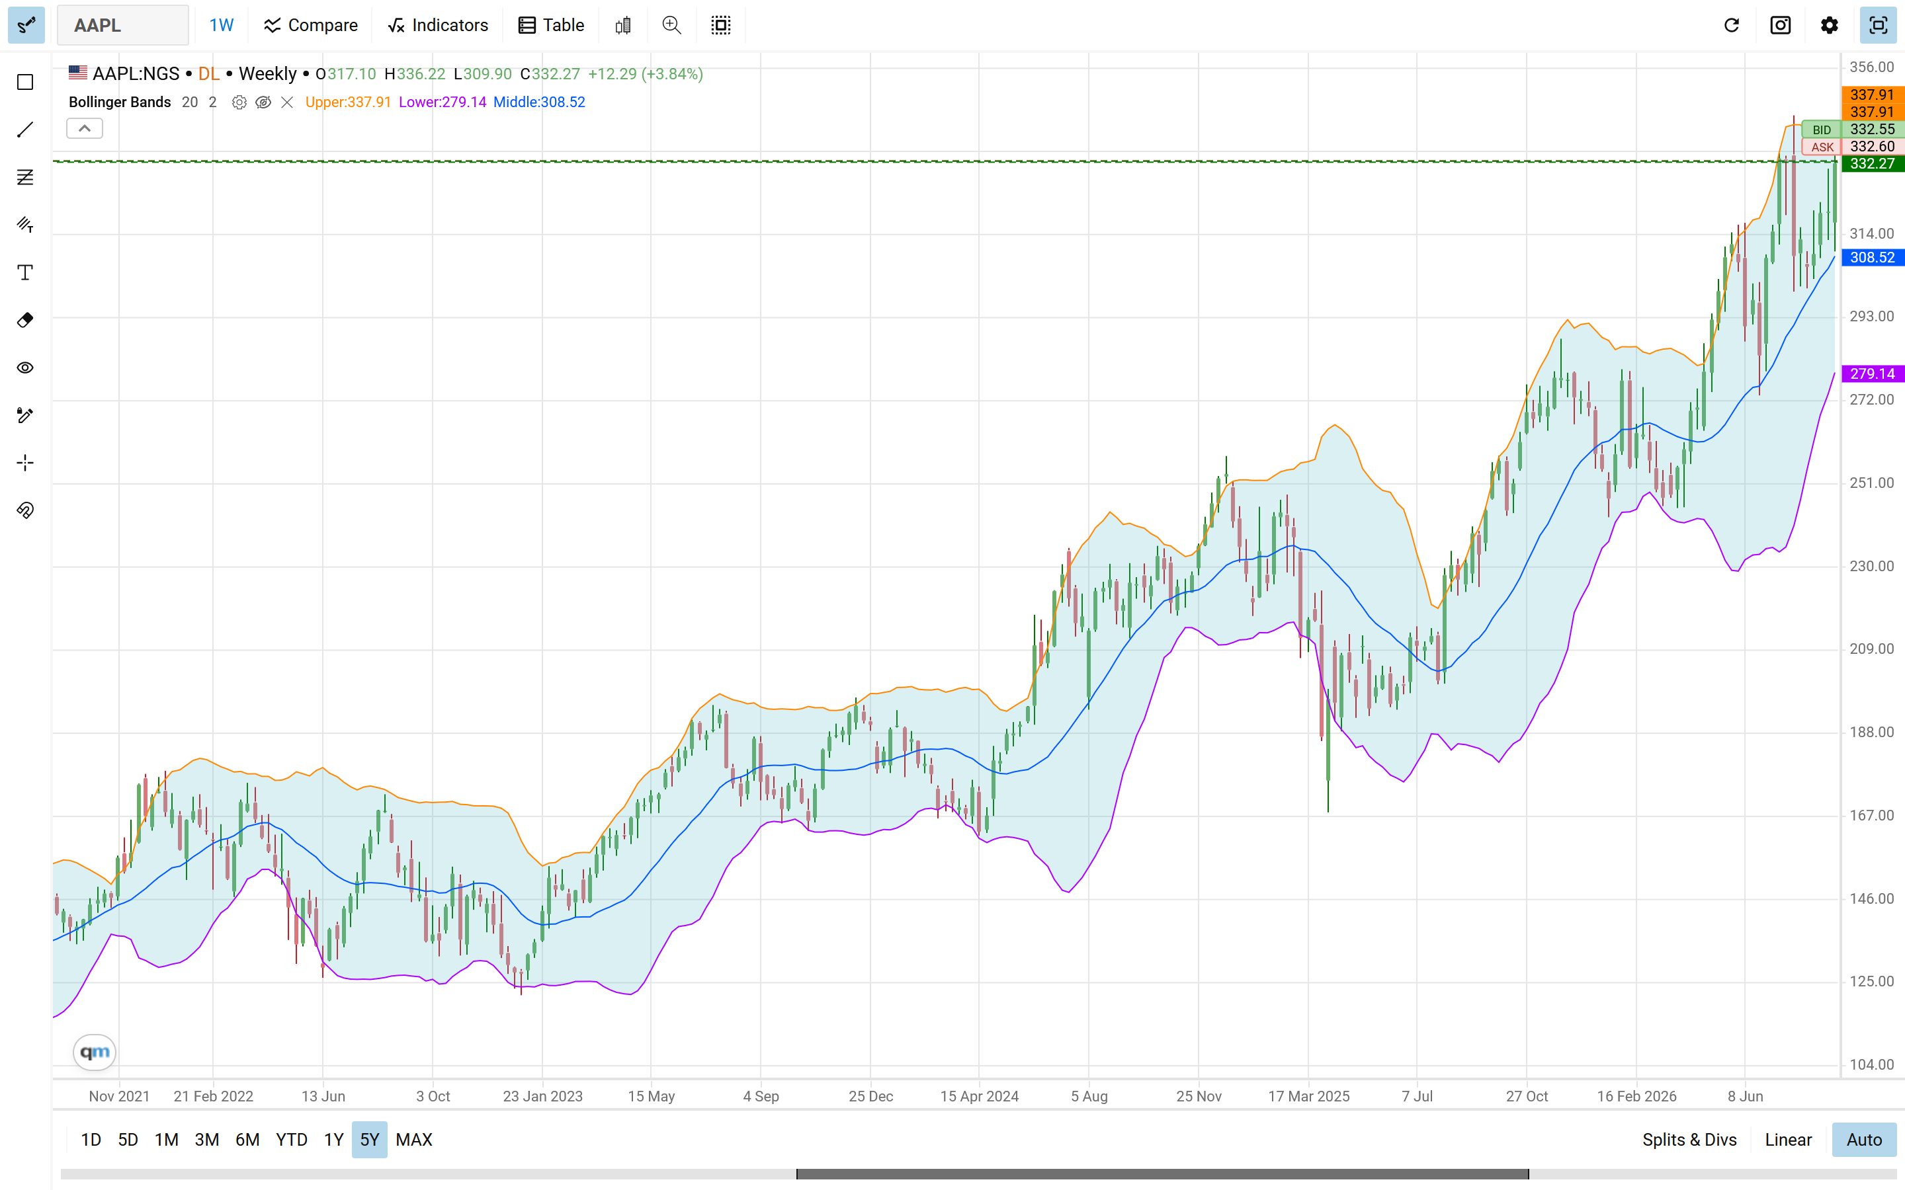
What is the value of Apple
How much is apple worth today?
Would you buy or sell?
How much would you be willing to pay?
What drives value?

Slide 5
What drives value?

Slide 6
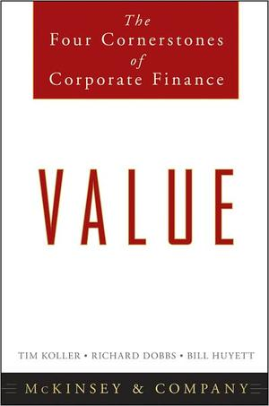
Value Drivers
Value
Cash Flows
Risk
ROIC
Growth
Cost of Capital
Chapters 1, 2 and 3 of Koller et al., (2010)
Notes:
The simplest approach is the following
The value of the firm is the present value of all the cash flows we expect. Assuming constant growth this would be V=(FCFFt+1)/(wacc-g)
FCF equals the profit (NOPLAT) minus investments: FCF=NOPLAT(1-Investment rate)
We also know that growth, g, comes from re-investments and how much we can earn on them: g = ROIC x Investment Rate
Therefore, the simplest approach that binds all together is V = (NOPLATt+1 * (1-g/IR)) / (wacc – g)

Slide 7
A company decides to replace 80% of its employees with AI. Its Value will Go:

Slide 8
How value is created
Optimal Financing Mix
Invest in Profitable Projects
Increase Share Value
Decide how profits are utilized
Create Value
Notes:
Maximize value
Financing Decision
Find the right financing mix that minimizes cost
Investment Decision
Find Investments that earn more than they cost
Dividend Decision
If you cannot find good investments, distribute cash

Slide 9
Value is only a financial objective and does not consider other qualitative objectives like Employee satisfaction, or Gender Equality Etc.

Slide 10
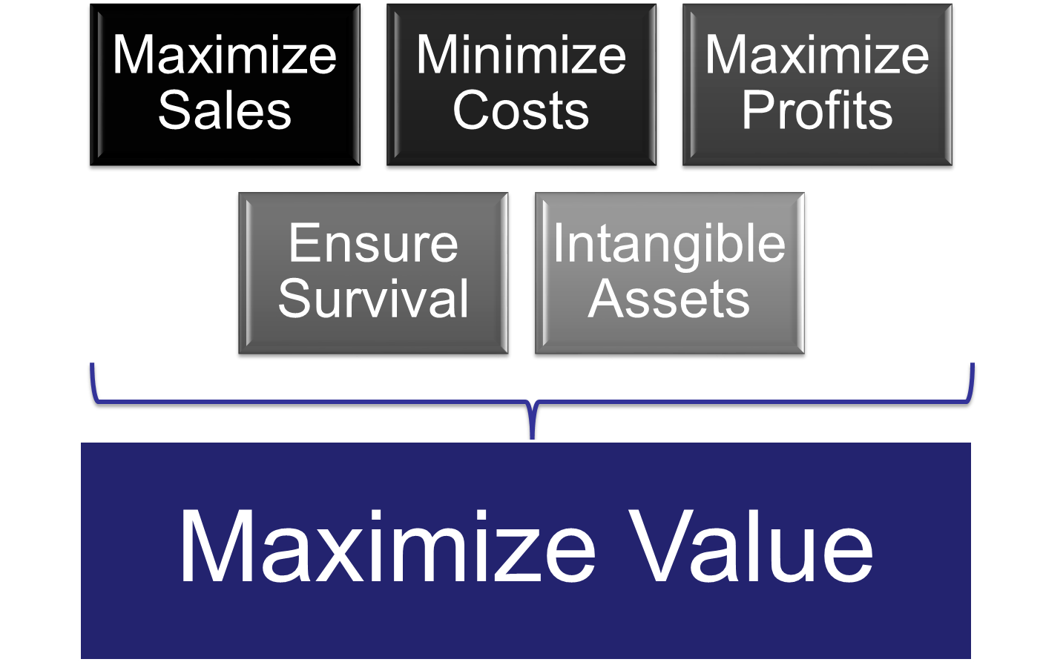
Why Value?
Is value a good enough measure of firm performance?
Stakeholder theory (Freeman, 1984)

Slide 11
Why Value-Stakeholders
Managers
Owners
Society
Markets
Lenders
Shareholders and Managers share the same views on project profitability
The riskiness of the firm does not change till maturity
The social impact of firm’s actions is negligible
Markets are assumed to accurately reflect information about the firm
Notes:
However things could go wrong
Agency Problems
Owners want higher dividends
Managers want to invest for growth
Wealth Transfer
Lenders provide finances assuming stable risk
Managers might decided to increase risk to increase profits
Market Efficiency
Information provided is filtrated
Markets suffer from behavioural bias
Social Impact
All social costs are not traced back to firm
Social benefits are difficult to measure

Slide 12
Why Market value?
It reflects investors opinions about
The quality of the investments
The riskiness of the firm and thus, its cost
Quality of decisions-management
Maximizing stock price does not mean that
We do not care about employees
We do not care about customers
We do not care about social interactions
If investors are rational (are they?), stock prices reflect the wisdom of decisions
Instantaneously
Are updated continuously

Slide 13
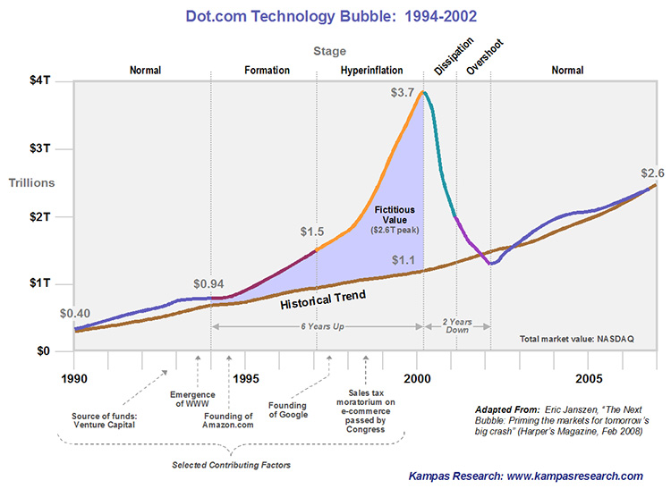
Do Markets Always reflect The “Fair” Value?

Slide 14
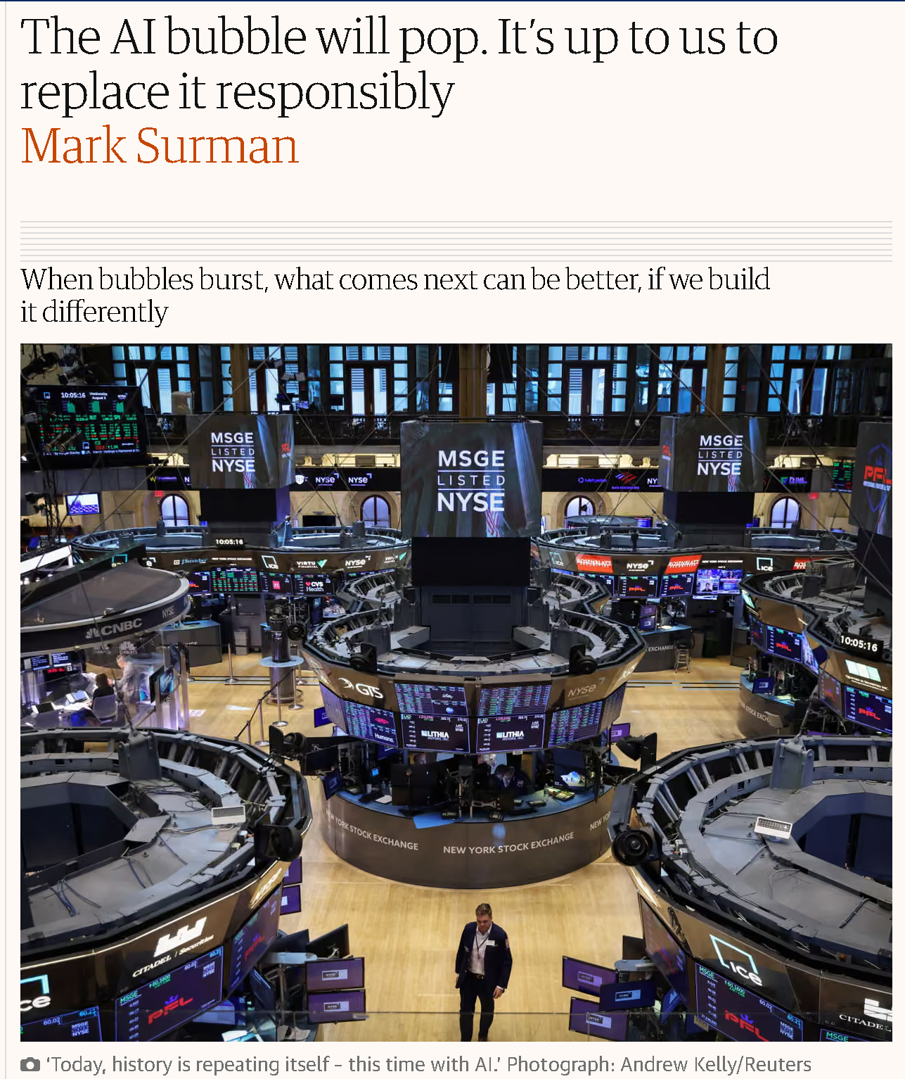
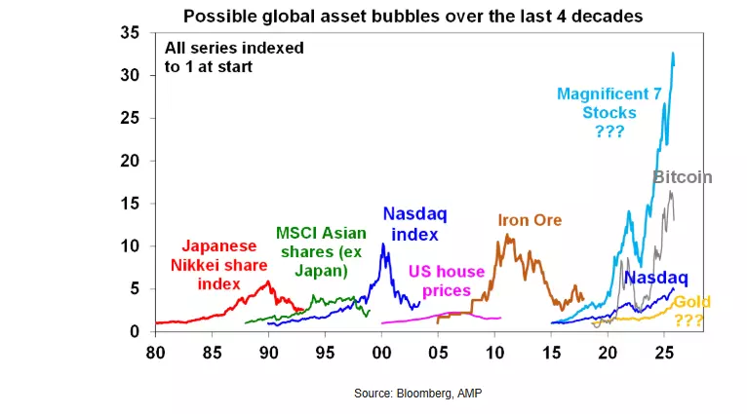
Is AI a Bubble ready to crash?
Notes:
https://www.theguardian.com/commentisfree/2026/jan/30/ai-bubble-mozilla

Slide 15
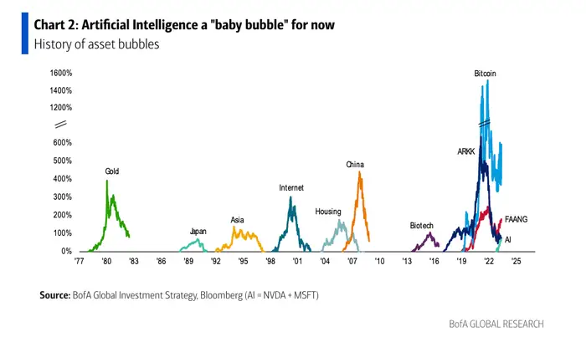
It goes that way

Slide 16

How Does Disney Look Like?
Notes:
Data taken from
https://www.quandl.com/data/EOD/AAPL-Apple-Inc-AAPL-Stock-Prices-Dividends-and-Splits

Slide 17
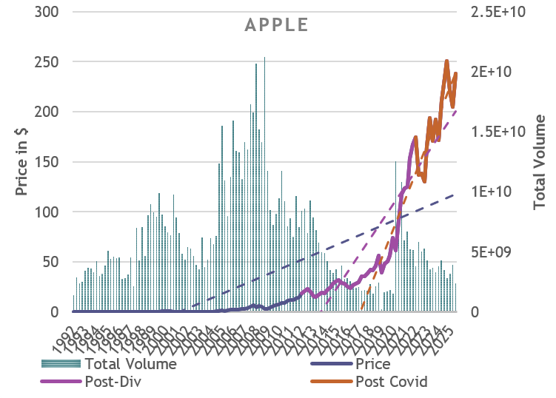
How Does Apple look like?
Last and this year
Notes:
Data taken from
https://www.quandl.com/data/EOD/DIS-Walt-Disney-Company-The-DIS-Stock-Prices-Dividends-and-Splits

Slide 18
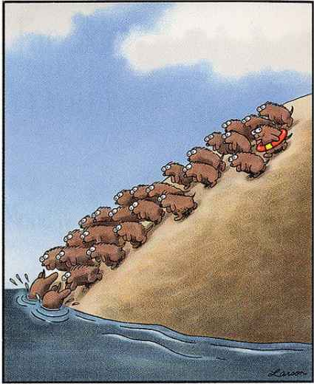
How do Markets look like?
Notes:
You can read chapters 6, 7 and 8 from Koller et al., (2010)

Slide 19
Initial Thoughts
“One hundred thousand lemmings cannot be wrong”
  Facebook
    Initial valuation: $104b or $38/share
    Next day: $34
    Today’s price: 326.34 (last year $274.5)
  Twitter
    Valuation: $1b
    Critique: $0
    IPO: $1.8b, $26/share
    First Day: $45.10/share
    Today: $38.12 (last year $48.06)

Slide 20
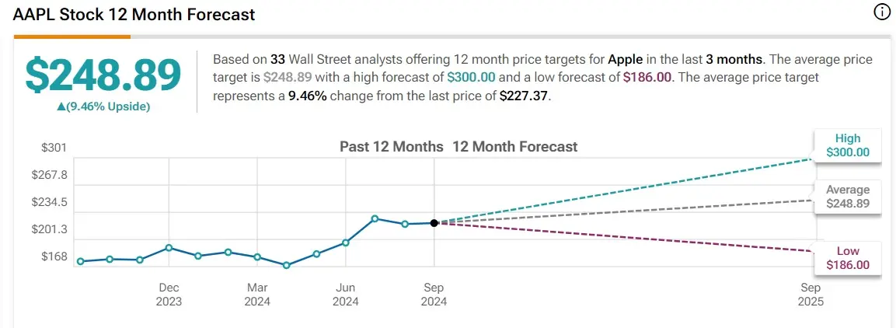
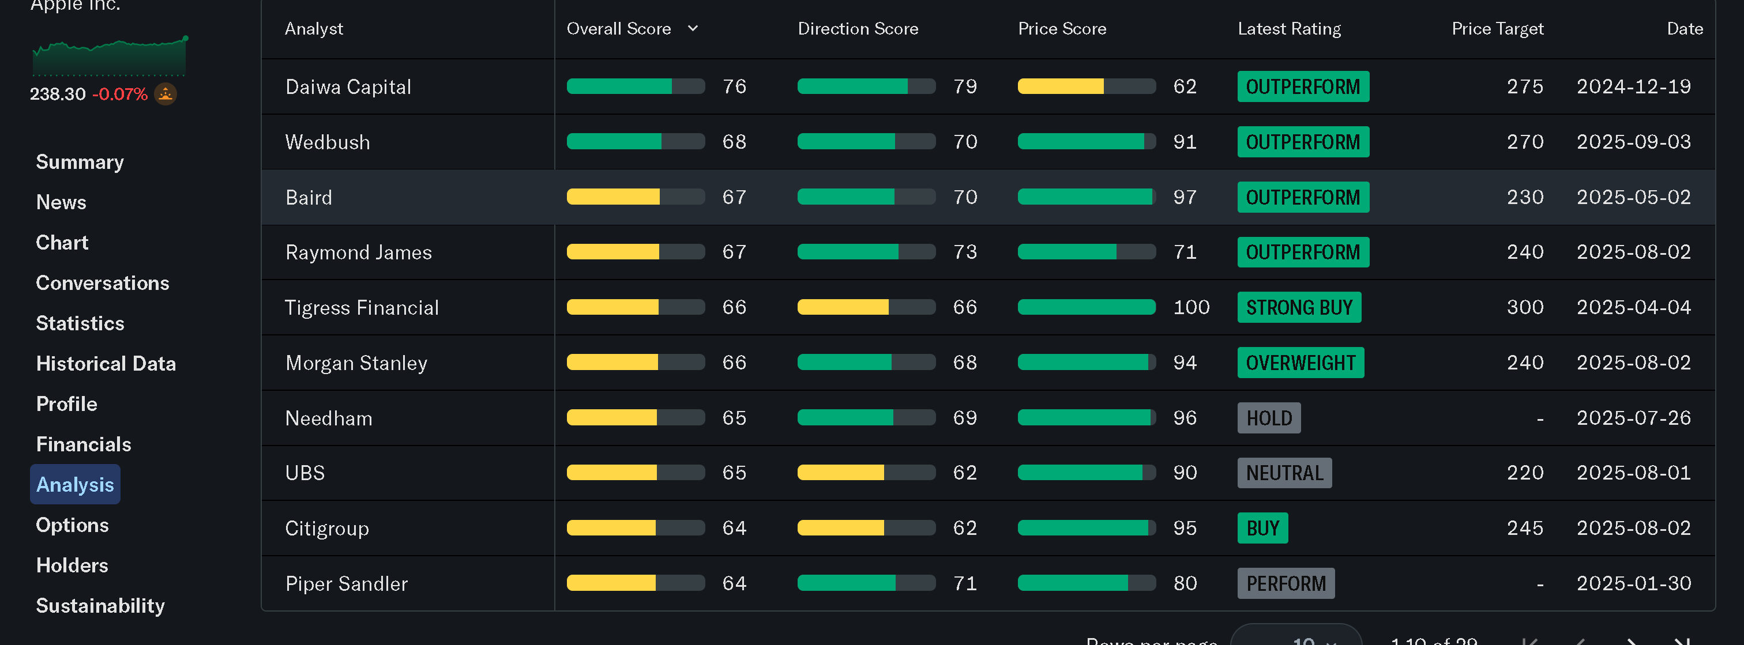
We Are Talking About the Future Who knows?
Who was right last year?
Notes:
https://finance.yahoo.com/quote/AAPL/analysis/?p=AAPL
https://watcher.guru/news/us-stock-apple-price-prediction-for-2025

Slide 21
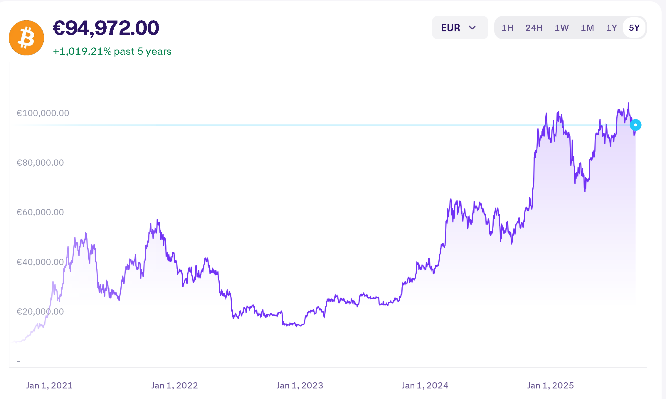
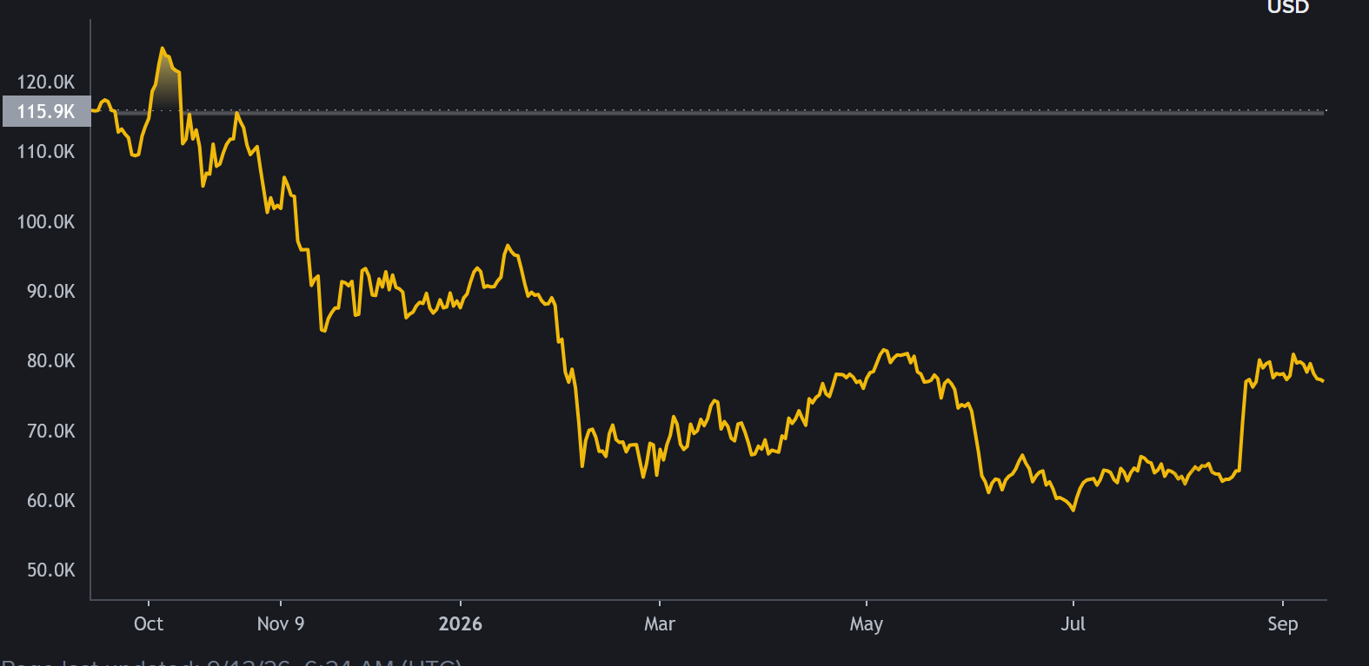
How does bitcoin look like?
Bitcoin might go up to $400k
Bitcoin is worthless
Do we really want Bitcoin?
Cryptocurrencies and FED interest rates
Notes:
Data taken from
https://goldprice.org/fr/cryptocurrency-price/bitcoin-price

Slide 22
Three Fundamental Problems
BIAS
All valuations are biased
Uncertainty
There are no precise valuations
Higher Uncertainty-Less Precision-Higher Risk-Higher Payoff
Complexity
A valuation cannot estimate the “TRUE” value
More Complex models-More inputs-More uncertainty-less precision
Simpler models are more flexible
Notes:
True Value vs Estimate: The Problem of Valuation Bias
Sources of Bias
Who provides the information
Annual Reports: Managers’ bias
Independent Reports: exogenous bias
Stock Exchange: Traders’ bias
Institutional factors
Reward Mechanisms-Who pays you to provide the valuation? If you are paid proportionally to floating, then you are biased upwards……
Manifestation
Inputs (assumptions)-Apple, Dell and Blackberry
Post-valuation (premium-synergy)
Qualitative factors (strategic-intangible)
Dealing with Bias
Reduce Institutional Pressure (e.g. Sell recommendation)
De-link valuation-reward (bonus)
Self Awareness
Be Informed and double check the plausibility of your assumptions.
Precision of Estimate: The problem of Uncertainty
Sources of Uncertainty
Estimation Uncertainty-Estimation errors
Real Uncertainty (random / un-foreseeable events)
Firm-specific
Macroeconomic
Responses to Uncertainty
Healthy
Better Models
Valuation Ranges
Probabilistic Statements
Unhealthy
Personal credit when right / Blame someone else when wrong
Ignore Fundamentals-Reserve to simpler approach
Dealing with Uncertainty
Improve firm-specific estimations
Incorporate real uncertainty in valuation methods (e.g. Discount rates)
Sophisticated Models: The problem of Complexity vs Uncertainty
Sources of Complexity
Better access to technology
Better access to information
Cost of Complexity
Information Overload
Black-Box Syndrome
Complicated model
Input-Output, but no analysis
More complex models employ stronger assumptions
Dealing with Complexity
Choose the simplest (more parsimonious) model
Avoid estimating more inputs (increases uncertainty)
Avoid All-In-One models. They are complicated and biased.

Slide 23
How Can we measure value?
How much is it worth?
Intrinsic Value
DCF-Present Value of Future Cash Flows
How much are you willing to pay
Expectations
Relative Valuation-What are others willing to pay?
Does flexibility have value?
Can I take an action in the future?
Options Valuation

Slide 24
Valuation approaches
1. Discounted Cash Flow
Present value of Future Cash Flows
2. Relative Valuation
Comparable Assets
Industry-Market environment
3. Contingent Claims
Exercise of Options
Alternatives
All valuation models are based on the assumption that market is inefficient the questions are:
  How far is market value from the true value?
  When will they converge?
If markets were efficient, market prices should reflect the true values. No need for valuation.
Notes:
REMEMBER
Q. What do we mean by the phrase “efficient market hypothesis”?
A. Prices only change when there is new information. Prices adjust immediately to this information. All investors are assumed to be risk averse and have homogenous expectations (i.e., all investors have the same attitude to risk and they expect the same thing to happen to Apple or BB or Dell etc.)
Things to note
Q. Does a risk averse investor avoid risk?
No. A risk averse investor is willing to undertake extra risk, when there is extra return.
Q. Do investors have homogenous expectations?
A. It is very unrealistic to assume that investors expect the same thing the same moment. For example, when Nokia launched L920, some investors were disappointed and some believed that it will be more than enough for the come back. The same happens now with BB10 etc. etc.
Some further info
http://www.investopedia.com/university/concepts/concepts6.asp#axzz2KdF3slZj

Slide 25
1. Discounted Cash flows (DCF)
The value of the asset is the present value of future cash flows
  We consider Cash flows to equity (FCFE) or to the firm (FCFF)
  Some of the FCF need to be positive, for an asset to have value
  Assets that generate cash earlier, have higher value
Inputs
  Life of the asset
  Cash Flows
  Discount rate
Philosophical basis
  Every asset has a(n) (intrinsic) value, based on fundamentals
  Markets are assumed to be efficient over time (not immediately) incorporating new information.
CF is Cash Flow, r is the discount rate and n is the life of the project

Slide 26
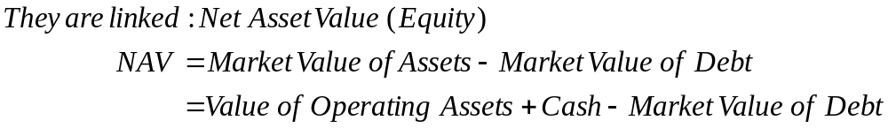
DCF-Further Considerations
Going Concern versus Liquidation
  Liquidation: Looking back can give the value of the business in the past. READING
  Business Continue and will invest in new projects. Growth is an important aspect of valuation
Equity or Firm Valuation?
  Firm Value
    The market value of a company’s operational assets
    Discount FCFF using WACC
  Equity Value
    The value of firm’s equity
    Discount FCFE using Cost of Equity
What can you buy in a stock exchange???
Notes:
REMEMBER
When we refer to the value of the firm value, we mean the value of the firm’s operating assets. All valuation models try to forecast future cash flows to the firm (growth and profit margins) coming from operating assets. CF generated by cash holdings or cash equivalents do not refer to operations and they are not considered in evaluation models. However, firm’s value (operating assets) and Value of Cash gives the value of total assets.
The difference between value of Total Assets and Debt is the residual disposable value after liquidation that goes to existing shareholders. This is Equity (Net Asset Value)

Slide 27
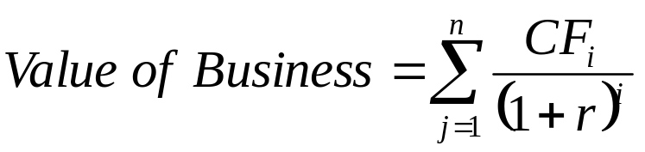
Dcf-Estimation
Classic DCF Valuation
  Firm Value: FCFFs are discounted using WACC
  Equity Value: FCFE (e.g. Dividends) are discounted using Cost of Equity
Adjusted Present Value
  Start with the value of an all equity firm
  Take into account borrowing (tax shield-bankruptcy risk)
Excess Return
  Start with capital invested
  Add the present value of excess returns

Slide 28
DCF-Final Remarks
Advantages
It is based on market fundamentals
Disadvantages
Requires more inputs
There is uncertainty and they can be manipulated
When DCF works best for:
Firms whose
Focused on value rather than volatility (According to Warren Buffet: Buy business, not stock)
Focus on the firm, not the market
Markets might be efficient (No need for valuation)
Investors who
Have a long term horizon (values tend to converge to “true” value)
Have the capacity to drive market value close to the “true” value (e.g. To buy the whole firm)
CF are positive and reliable and
risk is measurable

Slide 29
2. Relative Valuation
The value of the asset can be found by looking at the market prices of “similar” or “comparable” assets.
Inputs
  Group of “similar” or “comparable” assets
  Standardized measure of value
  If assets are not comparable: “Control” variables
Philosophical basis
  The “true” value of an asset is impossible to estimate. The value we can observe is the price the market is willing to pay.
  Markets are assumed to make mistakes, which are easier spotted in comparable assets and they are more quickly corrected.
Notes:
An excellent reading about market valuation and market momentum:
“If you are investing because you believe that other people will buy it and not because you know something about the fundamentals of the asset; then you are speculating”
https://www.theguardian.com/technology/2018/jan/15/should-i-invest-bitcoin-dont-mr-money-moustache
Relative Valuation roots in “The Greater Fool” Theory
You should be willing to pay a price no greater that what you think you will be able to sell the asset for, when you decide to. For example, the maximum price you would be willing to pay for a house today should be lower than what you believe you can sell it in the future. Under this idea you need to evaluate an asset according to the price of other “comparable” assets.
Things to note.
The term comparable assets, might not be as easy to define. For example, you might try to argue whether facebook and twitter are comparable or not? Also, is Apple comparable to Dell, Nokia or Samsung?
Further info
http://en.wikipedia.org/wiki/Greater_fool_theory

Slide 30
Standardized Measures (Multiples)
Selection of Multiples
  Equity or Firm: Multiples can be scaled to
    Equity value
    Firm value
    Operating assets
  Market value can be scaled to
    Earnings (P/E)
    Book Value (M/B)
    Revenues
  Current, Trailing or Forward Values
Group Selection
  Identical firms
  Sector
  Valuation based comparables
Comparison
  Direct
  Peer Group average (Assumption: Average is representative)
  Peer Group average adjusted for differences (Control variables-might be biased)

Slide 31
Real Valuation-Final Remarks
Advantages-Market Oriented
Reflects Market conditions
Disadvantages-Information Aggregation
Tends to over/under-value assets according to market trends
When Real Valuation works best for:
Firms
Investors
Have a short term horizon (take advantage of short term mispricing)
Their performance is based on a benchmark
Many comparable companies, preferably listed
There is a standardized variable
Better for IPOs
Better for momentum strategies
Managers’ performance is comparable to the market
Less information needed
Based on Averages (e.g. Sector). Over- Under-valued stocks
Strong implicit assumptions
Market might be over/undervalued

Slide 32
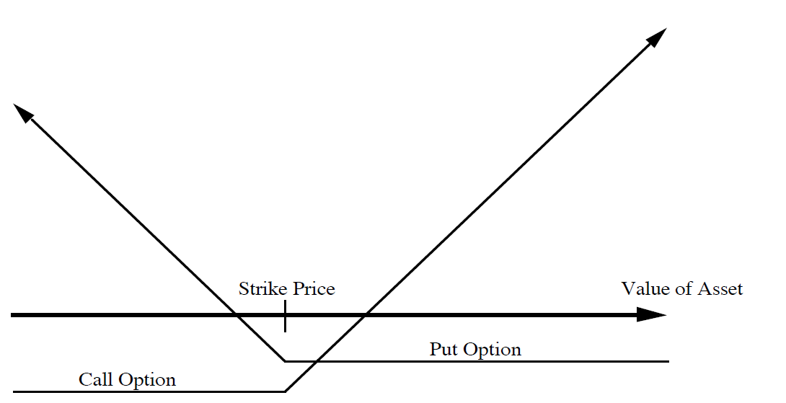
3. Contingent Claims-Options
Features
  Their value is derived from the value of the underlying asset
  The payoffs depend on the Spot and Strike prices
  They have a fixed life

Slide 33
Real Options-Further Remarks
Examples
  Direct
    Listed options
    Warrants (call, firm)
    Contingent Value Rights (put, firm)
    Scores and LEAPs (long term calls, market)
  Indirect (Real Options)
    Equity in deeply troubled firm
    Reserves owned by natural resource firms
    Patent rights/ exclusive license
    Right to expand
Advantages
  Allow for valuation of firms that we could not evaluate (non-comparable, non-profitable, high growth)
  Can deal with uncertainty and thus, they increase value
Disadvantages
  Many inputs are difficult to obtain (B&S formula)
  Underlying asset needs to be evaluated first
  Double-counting-Discount Rates and options

Slide 34
How does the course look like?
Thinks to note

Slide 35
Time Plan
What Will I learn?
# sessions | Topic
1 | Introduction
2-5 | DCF
6-7 | Relative Valuation
8 | Case Studies
9 | Assignment
10 | Revision
A mixture of Theory and Practice
Focus on Principles and Application
We will Learn “WHY?” AND “HOW?”

Slide 36
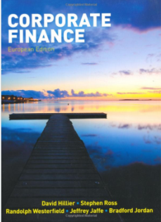
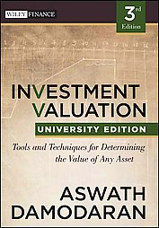
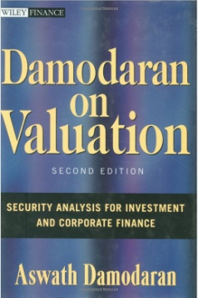
Mode of Study
A piece of group coursework
  Groups Deadline TBC
  Submission Dates TBC
Grades
  30% Coursework
  70% Exams
No single Textbook. References from various sources
  For Corporate Finance Issues, any text book. References from
    Corporate Finance, European edition, HILLIER et al., 2010
  Main Textbook references from
    Investment Valuation A. Damodaran
    Damodaran on Valuation ISBN: 0471304654
Mode of study
  BLACKBOARD
  Theoretical approach and practical application.
  Directed and independent reading
  Formal lecture contact and specialised workshops
  Group project

Slide 37
How can I perform well
Be here
Read newspapers
Read the textbook
  Valuation requires up to date knowledge about
    Firm Fundamentals
    Market trends
    Macro- and Micro-economic trends (Politics!!!)
Think
  challenge your old views
  There is no right or wrong
  Get Informed
Prepare and do not leave things for revision in the end
Try yourself all the examples and qualitative/quantitative data

Slide 38
Common Issues
Slides are taken from Damodaran
  I see my role training you in using his material
  Then this will be applied in real case studies
CW is too short
  You are supposed to prepare a marketable report. This is a skill to be developed
Difficulties in developing assumptions
  Valuation is a point of view. You are supposed to have one
  There are no good or bad assumptions, only good and bad arguments
I feel lost/Material is incomprehensible
  Valuation is an overview of the firm. We are supposed to combine all available information
  DO NOT LEAVE THINGS TO BE REVIEWED AT THE END
When in doubt: DO ASK

